Slide 1
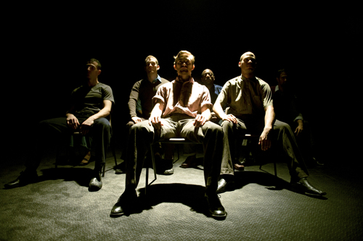
PHYSICAL THEATRE
Year 7 Drama
Lesson 4
Exaggeration

Slide 2
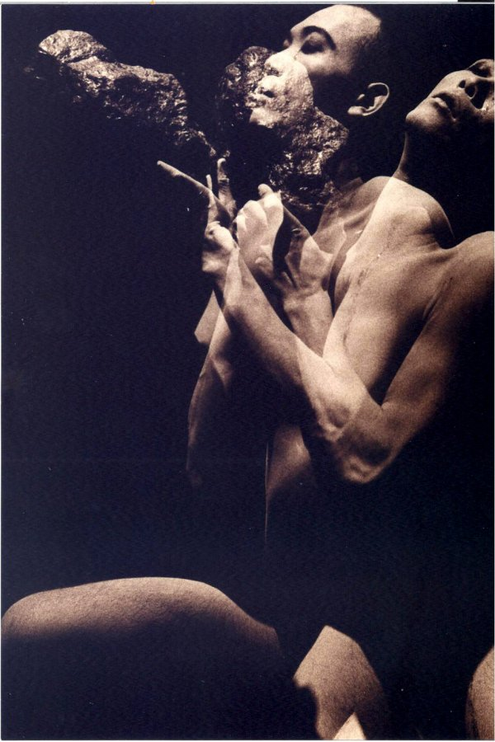
LESSON OBJECTIVE:
To understand how to present characters using the style of physical theatre

Slide 3
KEYWORDS
Lesson Objective:
To understand how to present characters using the style of physical theatre
To perform demonstrating a character.
Physicalisation
Non-naturalism
Characterisation
3 dimensional

Slide 4
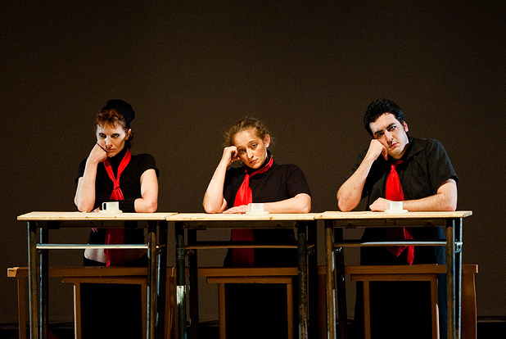
Register Skills
Lesson Objective:
To understand how to present characters using the style of physical theatre
To perform demonstrating a character.
When students answer the register, they have to answer stating a skill that is needed to make physical theatre effective

Slide 5
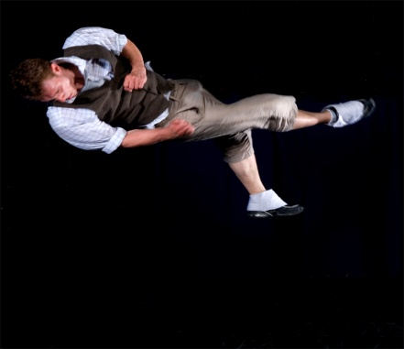
Teacher Demo
Lesson Objective:
To understand how to present characters using the style of physical theatre
To perform demonstrating a character.
Teacher demonstrates how a greedy person may act on stage in a ‘normal’ way and then in the style of physical theatre.
What was different about these two performances?
Physical theatre style was much more exaggerated in terms of movement and facial expressions.

Slide 6

Spot The Difference
Lesson Objective:
To understand how to present characters using the style of physical theatre
To perform demonstrating a character.
In pairs, students have to create a Still Image showing ANGER; one person in a naturalistic way, the other in a physicalised way (over exaggerated)
30 secs to create Still Image
One pair to be SPOTLIGHTED, a pair that shows a distinct difference.
Discuss with the rest of the class – What were the main differences?
Repeat with other emotions:
FEAR
HAPPINESS
FRUSTRATION

Slide 7
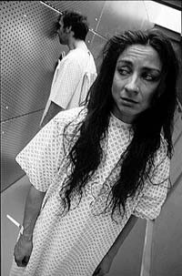
Developing a Character
Lesson Objective:
To understand how to present characters using the style of physical theatre
To perform demonstrating a character.
Students choose one of their Still Images to develop, but this time they are both using exaggerated movements.
Students begin in their Still Image and then choreograph 5 movements; both being the same type of character e.g. greedy/selfish/kind, etc.
FOR EXAMPLE:
GREED 1) Stepping forwards shovelling food into mouth, 2) Stealing and putting it into pockets
Students can move in different directions, but moving in the same way.
THE WAY YOUR MOVE SHOULD SHOW THE AUDIENCE YOUR TYPE OF CHARACTER

Slide 8
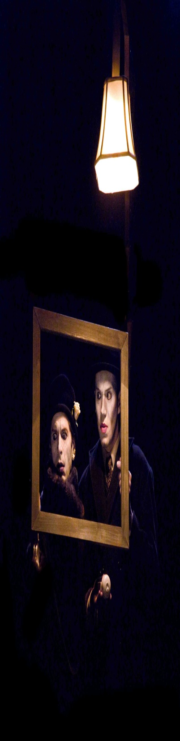
Adding a Script
Lesson Objective:
To understand how to present characters using the style of physical theatre
To perform demonstrating a character.
Students are each given a short script extract or create own dialogue in different pairs.
Each person has to be a different type of character e.g. angry, greedy,
Decide what your relationship is to each other, e.g. mother and son, lovers, friends, work colleagues, etc.
MOVEMENTS NEED TO BE CHOREOGRAPHED
For example: Angry v's shy
A: Hello. (shouting the line, grabbing hold of own hair)
B: Hello. (covering eyes, mouthing the words 'Hello')
A: You're late. (saying the line through gritted teeth, pointing at their partner)
B: I know. (whispering the line, facing the back crouching down)

Slide 9
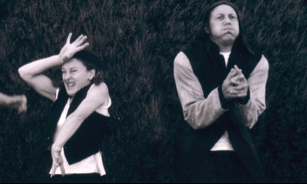
Performance
Lesson Objective:
To understand how to present characters using the style of physical theatre
To perform demonstrating a character.
Teacher to choose 3 pairs to perform to the others.
What type of characters were they?
How did we know this?
Was their performance convincing? Why/why not?

Slide 10
END QUIZ
Lesson Objective:
To understand how to present characters using the style of physical theatre
To perform demonstrating a character.
How do we perform our characters in the style of Physical theatre?
10 seconds thinking time
Get into pairs
Label yourselves A & B
Teacher will say who starts
Timed pair Share
Teacher will asks students at random what they think or what their partner thinks
Over exaggeration of movements / emotions

